Slide 1
energy and blockchain
@Haee_8.May.2019
Dr. Dimitrios Arvanitis
Hellenic Hydrocarbon Resources Management SA
www.greekhydrocarbons.gr
d.arvanitis@greekhydrocarbons.gr

Slide 2
what is blockchain
  simple definition
blockchain applications in energy
  case studies
Notes:
My presentation is about 2 issues and 2 parts

Slide 3
Working eclectic*definition
Blockchain is a decentralised and distributed ledger (database) which uses cryptography to link timestamped ‘blocks’ of data, thus creating a ‘history of events’ (transactions or other data entries) with the aim to be an irreversible ‘single point of truth’. Blockchain can be public or private and may have different permission levels.
*Cambridge dictionary: Methods, beliefs, ideas, etc. that are eclectic combine whatever seem the best or most useful things from many different areas or systems, rather than following a single system
Notes:
PART 1 – DEFINITION
I have tried to collect a ‘definition of definitions’ – personal eclectic definition
There are many different opinions on the subject

Slide 4
Ledger: database, sheet e.g. an excel sheet
Decentralized: unlike a centralized ledger that is kept on the server of a trusted institution (e.g. bank), blockchain runs on an entire network of computers; if part of the network fails or is compromised, the rest of the network remains intact
Distributed: each member of the network has the same copy of the ledger which is constantly updated
Cryptography: the method to secure the data and network
Timestamped history of events: every transaction or data entry is registered chronologically
Irreversible single point of truth: the goal is to have a highly secure, if possible immutable, ledger/history of events
Public: it is open and allows the transfer of data/ transactions between parties which otherwise would not trust each other, without the need for a trusted intermediary. Public blockchains have different security protocols, e.g. proof of work and proof of stake,
Private: public is open to everyone - no permission to join; private need a sort of permission to join

Slide 5
video – blockchain simply explained
https://www.youtube.com/watch?v=SSo_EIwHSd4

Slide 6
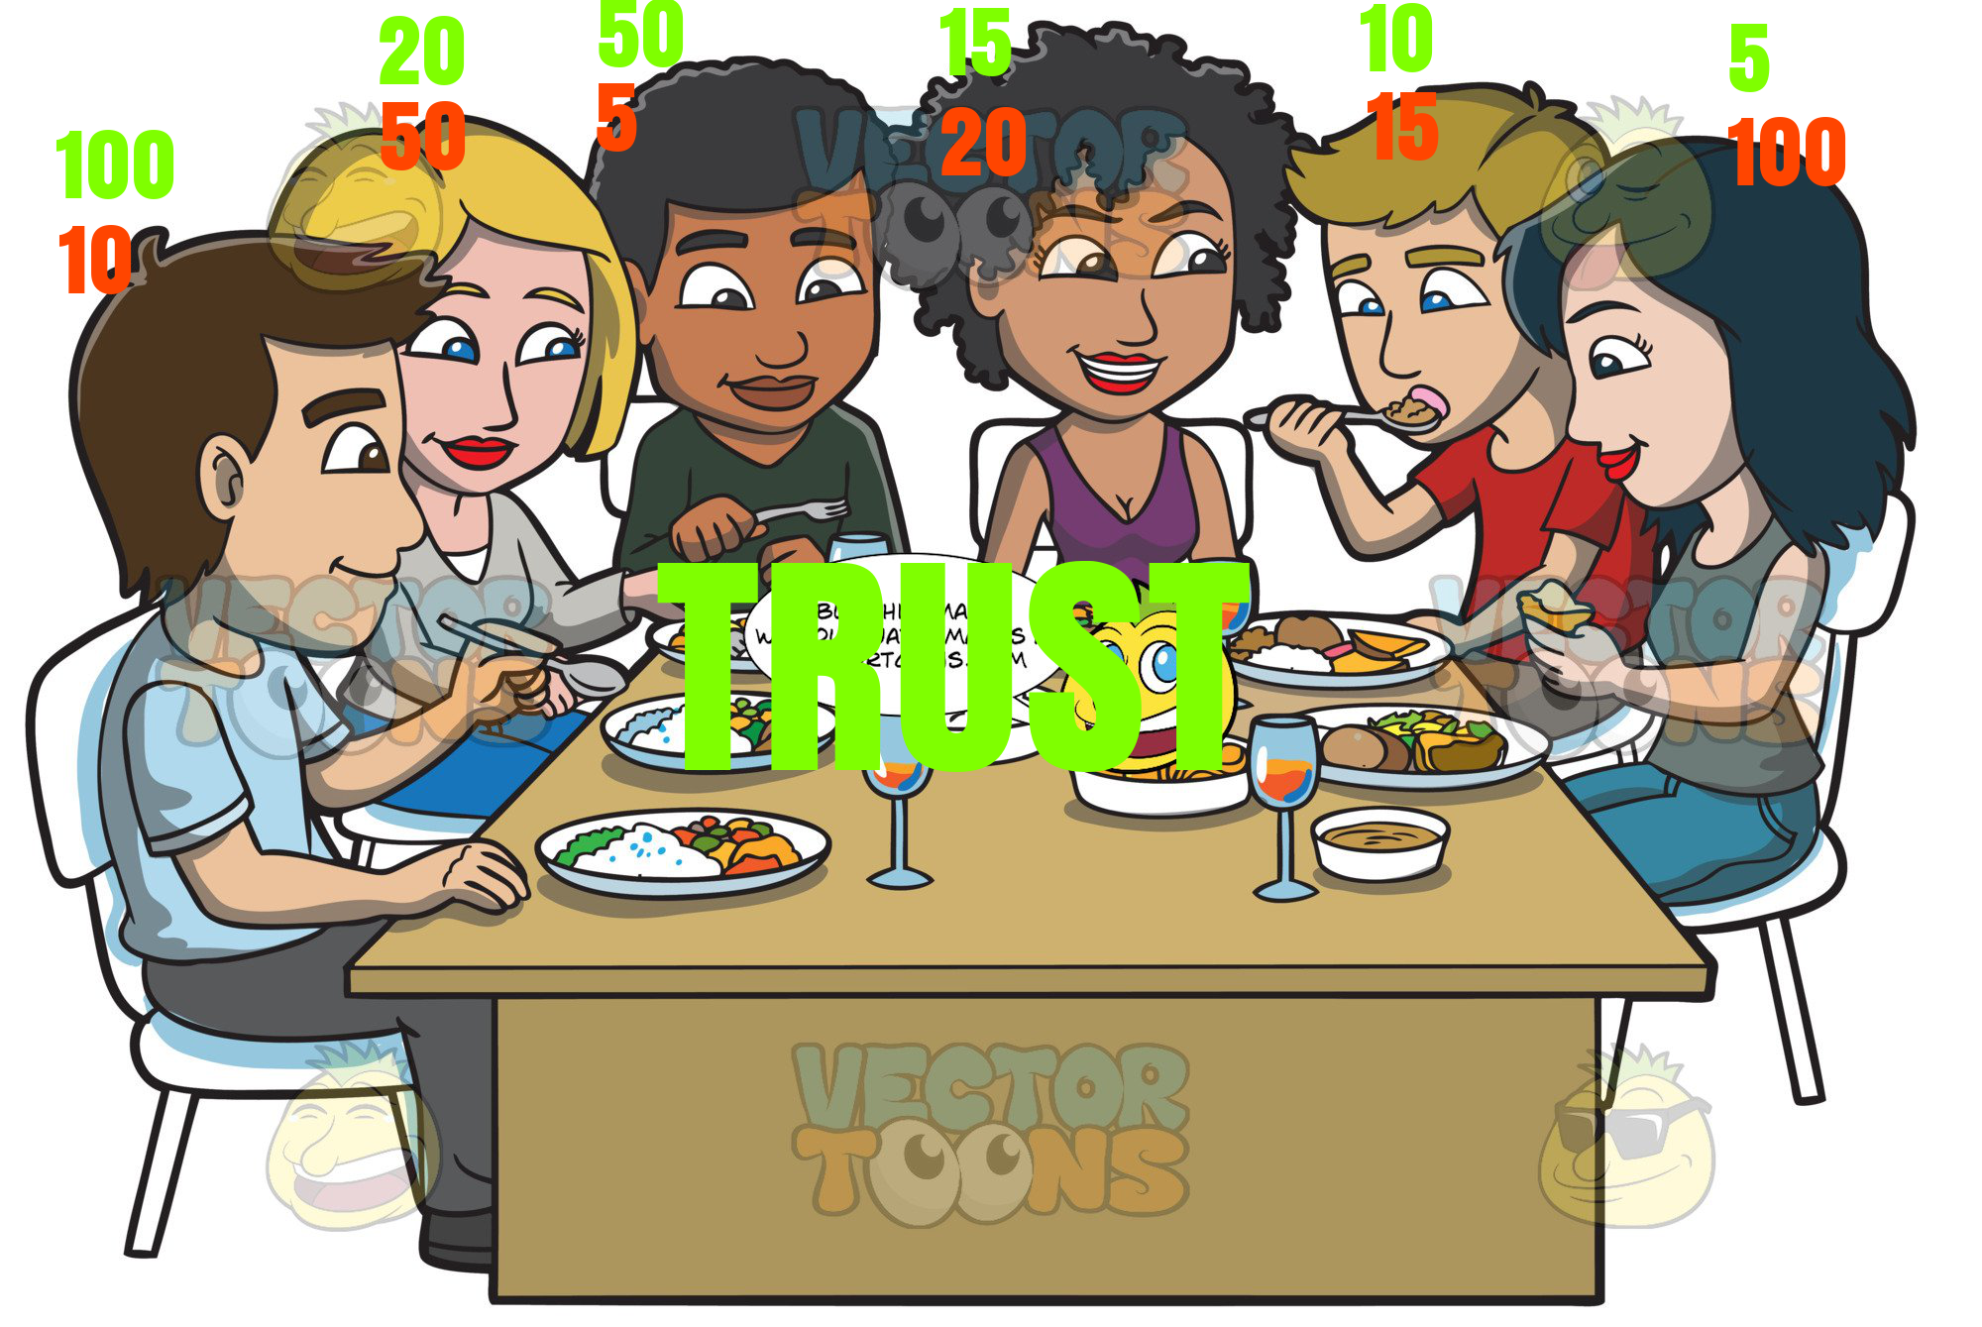

Slide 7
beware of the buzzwords
buzzwords and phrases
  The next ‘Internet’ – evolution of the ‘Internet’
  Allows the ‘transfer of value’
  Democratisation of the world – Fair elections
  Owning our private data/digital identity
  Registration of all property rights
  Revolution in healthcare technology
The buzzword problem? All these could become a reality in the future - but at this stage of evolution they blur the meaning of blockchain
Notes:
2 points before we move on to energy
Buzzwords
Bitcoin and blockchain

Slide 8
blockchain and Bitcoin
‘Satoshi Nakamoto’ publishes a paper in 2008 entitled
‘Bitcoin: A Peer-to-Peer Electronic Cash System’
The term blockchain does not appear anywhere – only the term ‘chain of blocks’

Slide 9
Abstract
A purely peer-to-peer version of electronic cash would allow online payments to be sent directly from one party to another without going through a financial institution. Digital signatures provide part of the solution, but the main benefits are lost if a trusted third party is still required to prevent double-spending. We propose a solution to the double-spending problem using a peer-to-peer network. The network timestamps transactions by hashing them into an ongoing chain of hash-based proof-of-work, forming a record that cannot be changed without redoing the proof-of-work. The longest chain not only serves as proof of the sequence of events witnessed, but proof that it came from the largest pool of CPU power. As long as a majority of CPU power is controlled by nodes that are not cooperating to attack the network, they'll generate the longest chain and outpace attackers. The network itself requires minimal structure. Messages are broadcast on a best effort basis, and nodes can leave and rejoin the network at will, accepting the longest proof-of-work chain as proof of what happened while they were gone.

Slide 10
blockchain and Bitcoin
Bitcoin is a blockchain (the 1st ever created) - but not every blockchain is Bitcoin
The meaning now is that of a separate technology, i.e. Blockchain Technology

Slide 11


Slide 12
DISCLAIMER
THE NEXT SLIDES ARE NOT ‘PRODUCT PLACEMENT’
DO NOT FOLLOW ANY ADVICE/STATEMENTS BY THE SPEAKER - IT IS PROBABLY WRONG
Believe Those Who Are Seeking the Truth; Doubt Those Who Find It*
  *Václav Havel? André Gide? François Truffaut? Marcel Proust? John Dingell Sr.? Luis Buñuel? Amanda Palmer? Voltaire? Anonymous? → quoteinvestigator.com
Notes:
Energy part - disclaimer

Slide 13
Blockchain applications in Energy
(1) Vast majority of applications in ⚡Electricity⚡
  Power generation
  distribution
  net metering
  prosumers
  aggregators
  Microgrids ≠ Centralised system [power stations > high voltage transmission > distribution]
(2) Generic trading platforms –which may be applied to energy products e.g. oil trading

Slide 14
Why is that ?
CEO of IBM Ginni Rometty
“what the internet was to information, blockchain is to transactions in terms of making them really cheap to record and easy to verify”.
Easy, cheap and effective management of a huge load of transactions or data is the most important advantage of blockchain for business applications

Slide 15
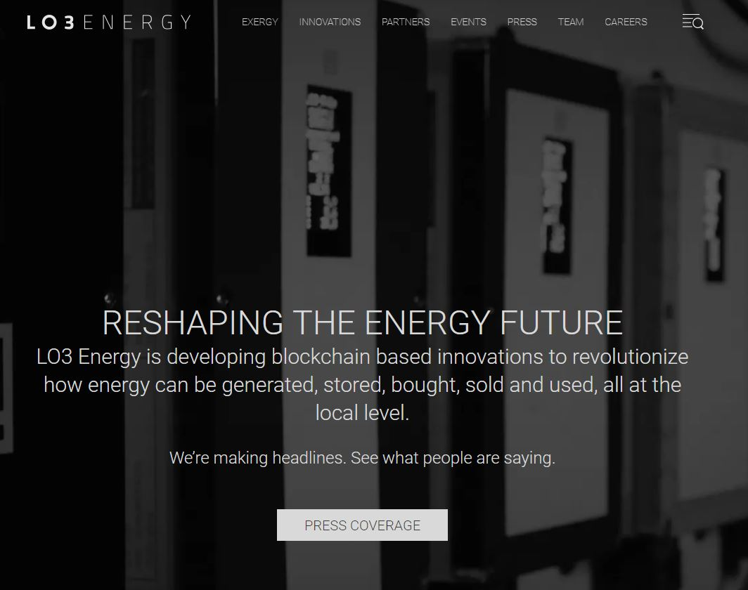
Notes:
Local level, micro grid, DSO

Slide 16
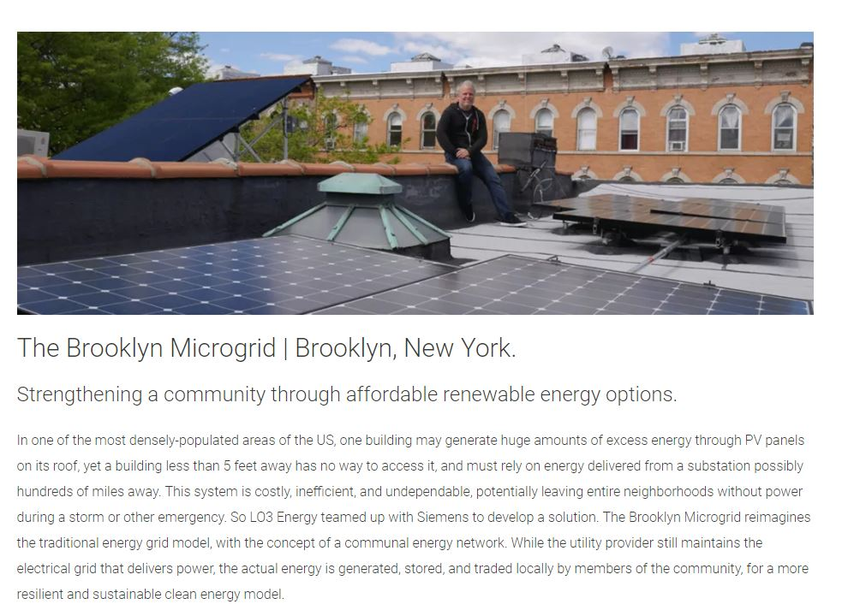

Slide 17
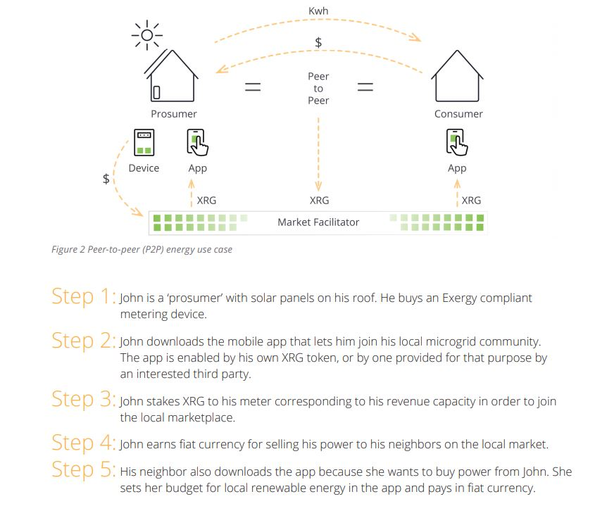
Notes:
MICRO GREED – PEER TO PEER – about prosumer / consumer /microgrid
LO3 Energy has already implemented a peer-to-peer use case, the Brooklyn Microgrid, but the full market value of peer-to-peer energy is just beginning to be explored. Our calculations show that, for residential customers in Germany alone, this market is worth $5 billion a year. Electricity retailers and distribution utilities generate revenue by selling electricity to customers and ensuring a reliable power supply. Last year, Europe’s 260 million electricity customers paid more than €115 billion for their electricity. Across the US, EU and Australia, customers paid $185 billion. As DERs continue to proliferate, so too will the ability to transact locally with other network participants. As the Exergy network grows, we envision that an increasing amount of this power will be sold not between utilities and customers, but between customers themselves, peer-to-peer, on the Exergy platform.

Slide 18
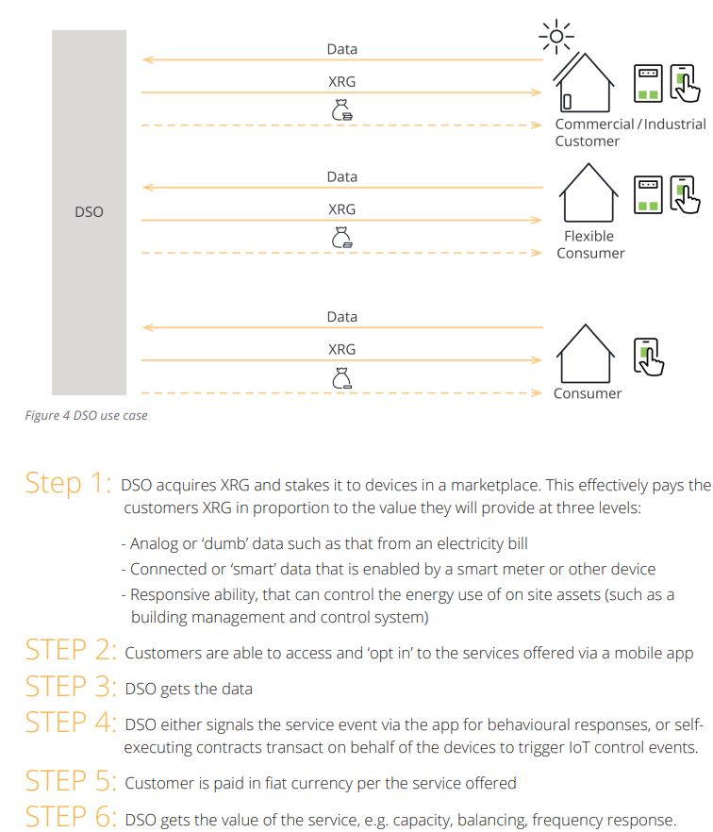
Notes:
DSO- distribution network operator – about DATA

Slide 19
fiat money - investopedia
Fiat money is government-issued currency that is not backed by a physical commodity, such as gold or silver.
The value of fiat money derives from the relationship between supply and demand and the trustworthiness of issuing government/central bank.
The term comes from the Latin word fiat which may be translated as “it shall be" or "let it be done.“
fiat currency refers to the notion that currency has value only because a government/central bank says it does.

Slide 20
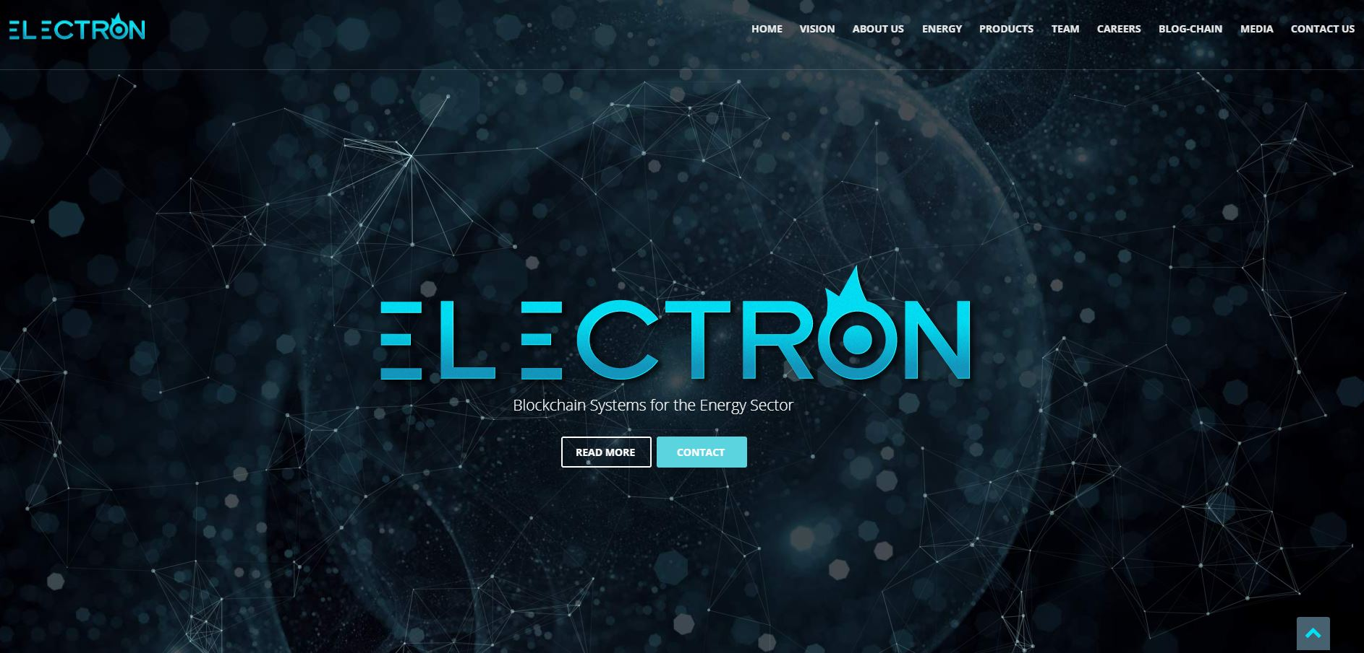
Notes:
UK - based

Slide 21
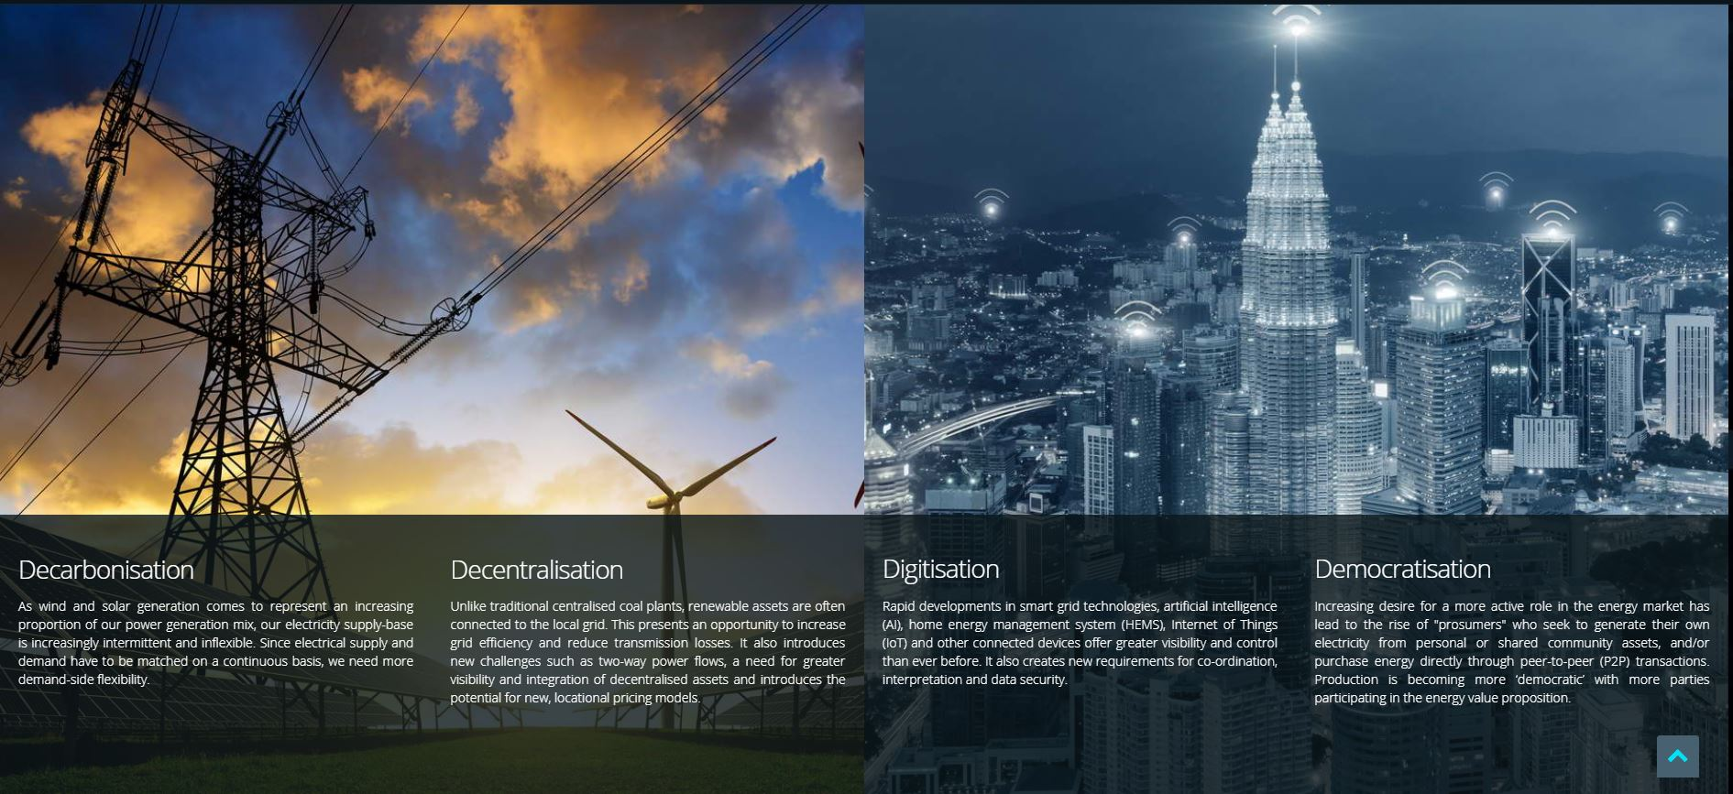
Notes:
https://www.finextra.com/pressarticle/70874/electron-wins-uk-government-award-to-advance-blockchain-in-b
https://medium.com/electron-blogchain/interview-jon-ferris-strategy-director-94fd7b9909ac
The core module is an Asset Register enabling shared end-to-end visibility of the assets connected to the grid, their characteristics and contractual commitments. The trading platform enables open development of apps where different products can be traded and retraded by these assets. This will enable better coordination between industry participants, and for the assets to discover the full system value of their capabilities — in short the platform enables the development of smart markets.

Slide 22

Notes:
PPA platform – power purchase agreements

Slide 23
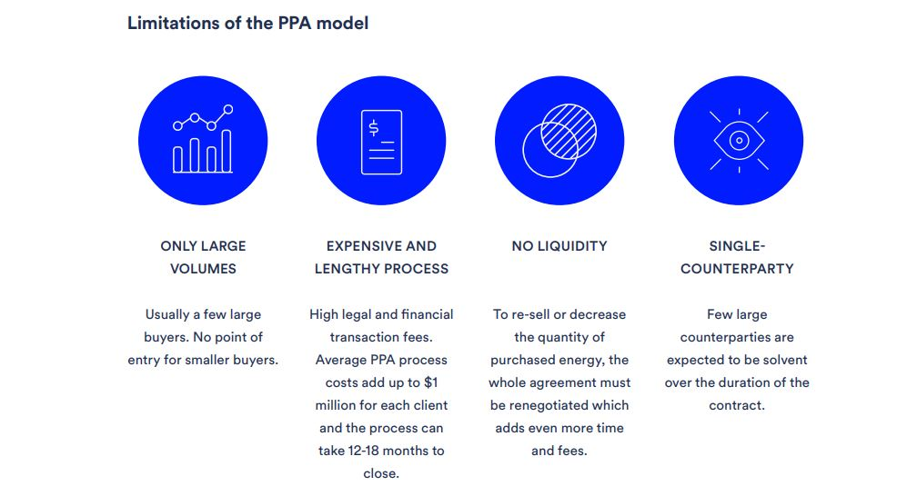

Slide 24
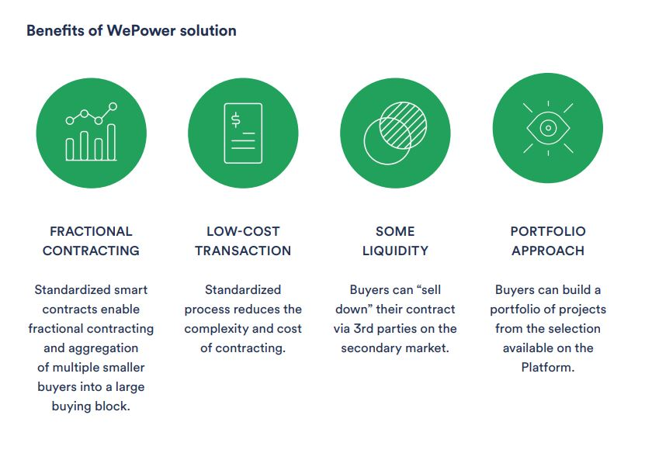
Notes:
Buyer aggregation

Slide 25
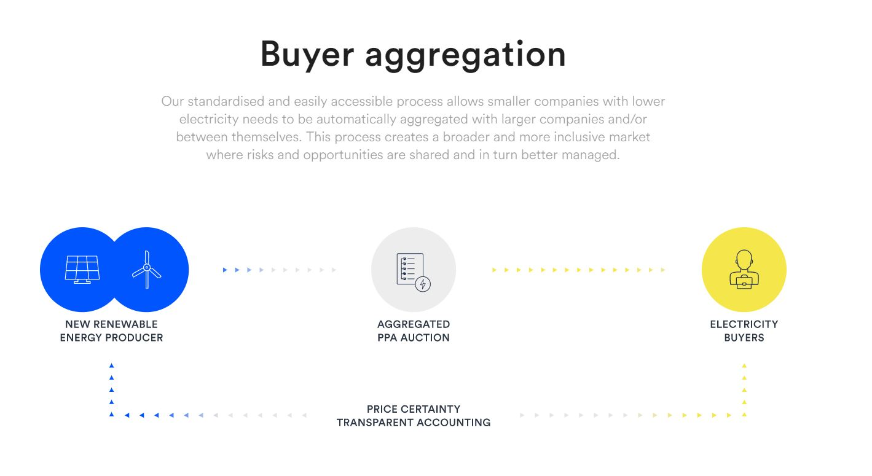

Slide 26
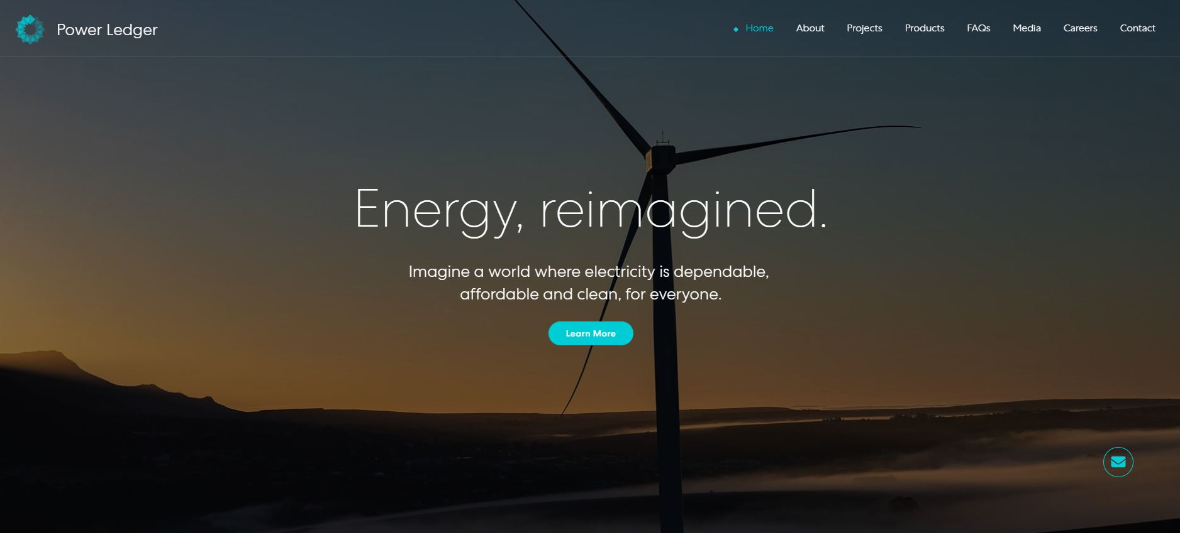
PowerLedger

Slide 27
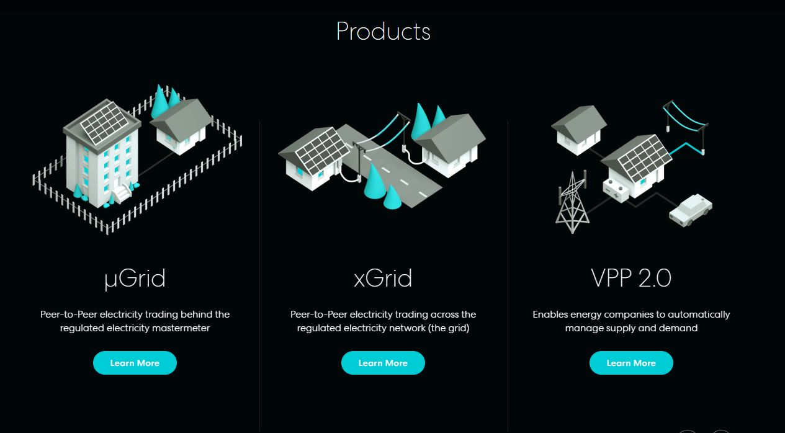

Slide 28
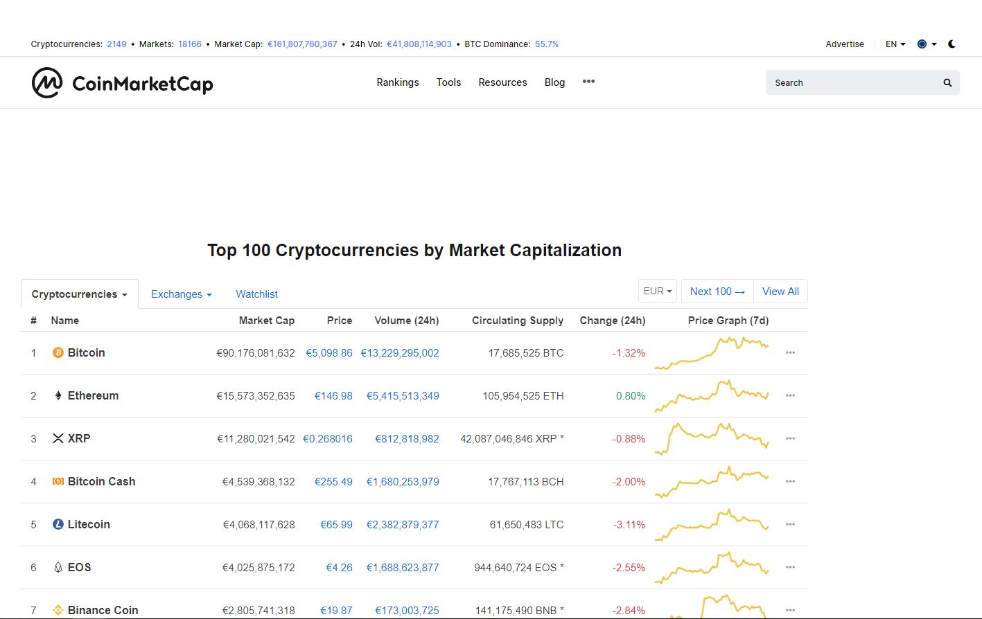
cinmarketcap
Notes:
Sneak preview into the Cryptoworld – difference between/// wepower and powerledger /// lo3 and electron

Slide 29
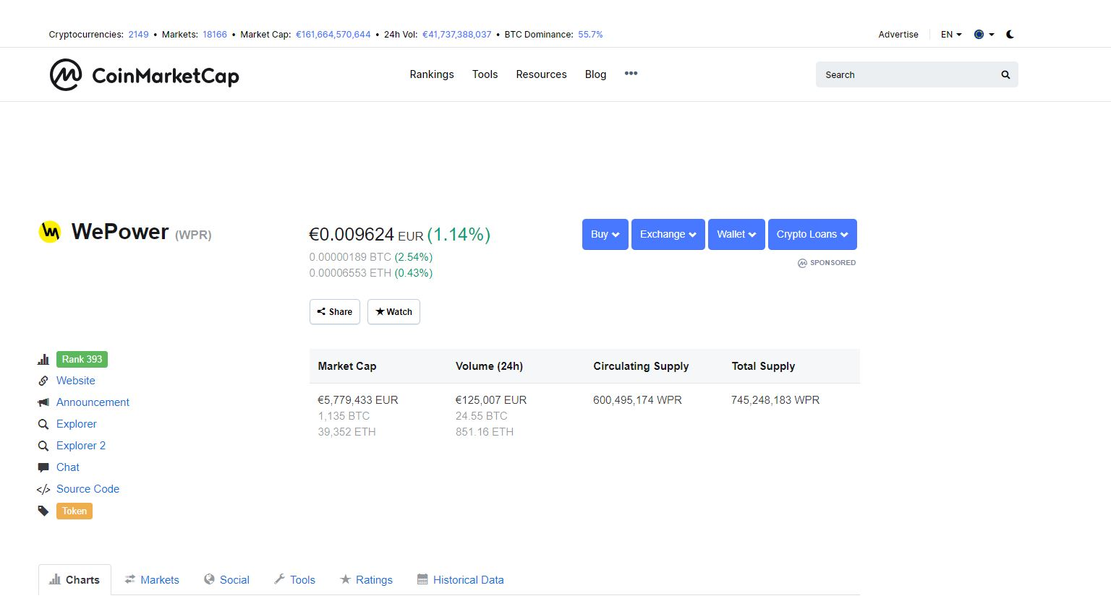
WePower-coinmarketcap

Slide 30
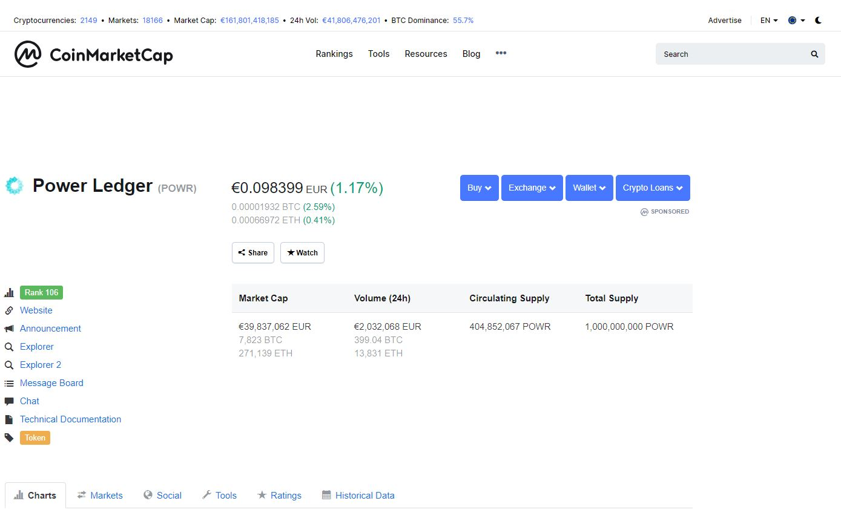
Powerledger-coinmarketcap

Slide 31

komgo

Slide 32
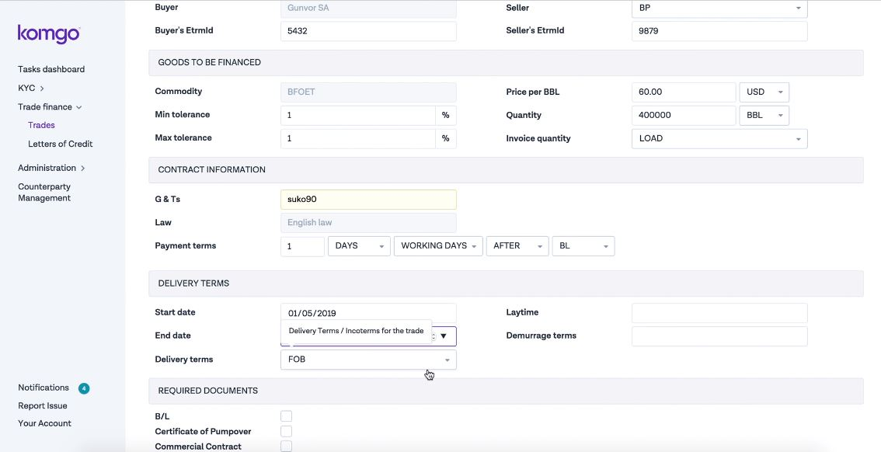
Notes:
Runs on etheruem

Slide 33
human-centered design
komgo was designed with streamlined usability as a guiding principle. The features of the komgo network are built to ensure smooth adoption and dissemination across the industry.
intuitive dashboard
The komgo dashboard is optimized for everyday application, ensuring all industry participants can operate with ease.
ease of integration
komgo was designed with seamless integration in mind. Although komgo’s solution relies on new distributed ledger technology, it is integrated with legacy IT systems to ensure smooth onboarding and management.
blockchain technology
The Ethereum blockchain is at the core of the komgo solution. The technology is applied in a federated context with 'privacy by design' features, guaranteeing access to data can be permissioned gradually or partially if needed.
trusted and secure components
The komgo network will redefine how industry players think about trust and security. 'Privacy by design' is core to the solution, ensuring komgo and other participants can only access data when given permission by the owner(s).
timestamped data management
komgo timestamps all data processed or transacted through its network, ensuring an immutable, transparent history about when participants provided or accessed certain data.
kite document transfer system
komgo uses a unique document transfer system known as kite. kite allows for verified documents to be securely exchanged between participants without komgo seeing any sensitive information.
industry interoperability
komgo and its partners have developed a protocol ensuring interoperability with other industry platforms.

Slide 34
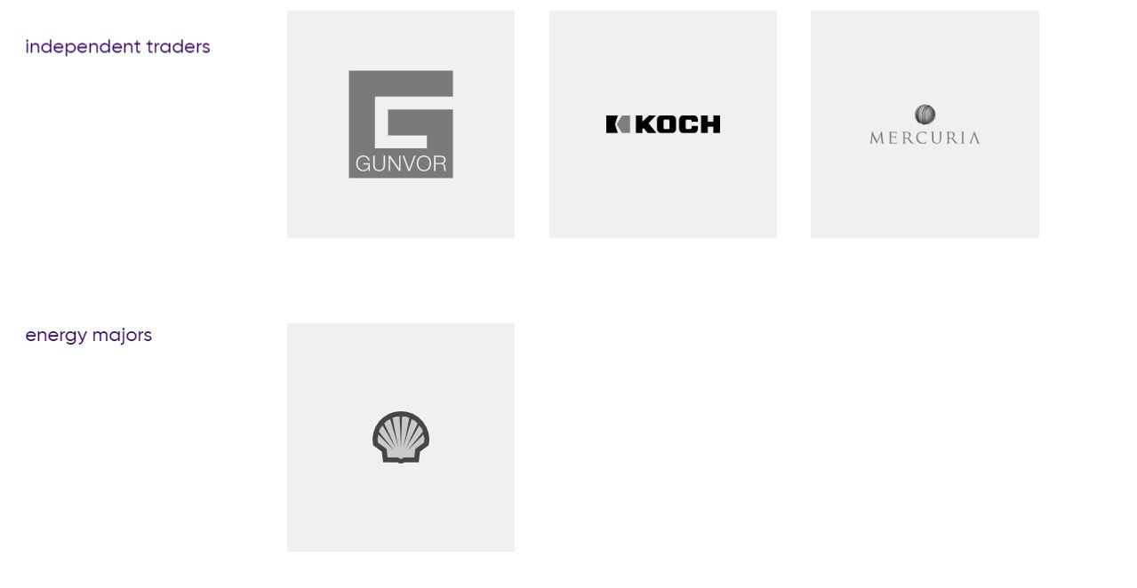

Slide 35
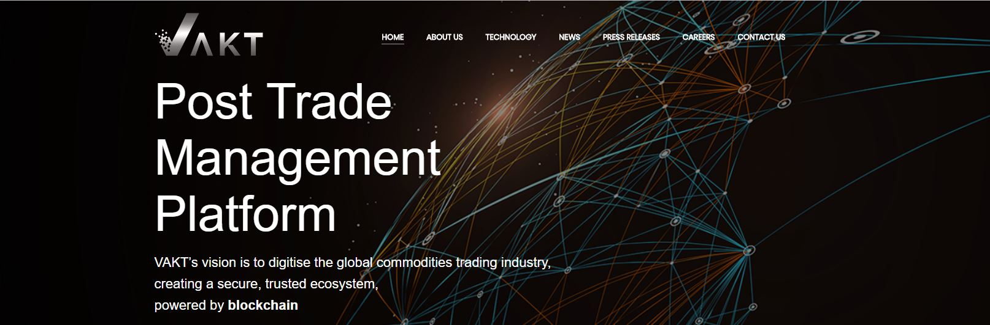

Slide 36
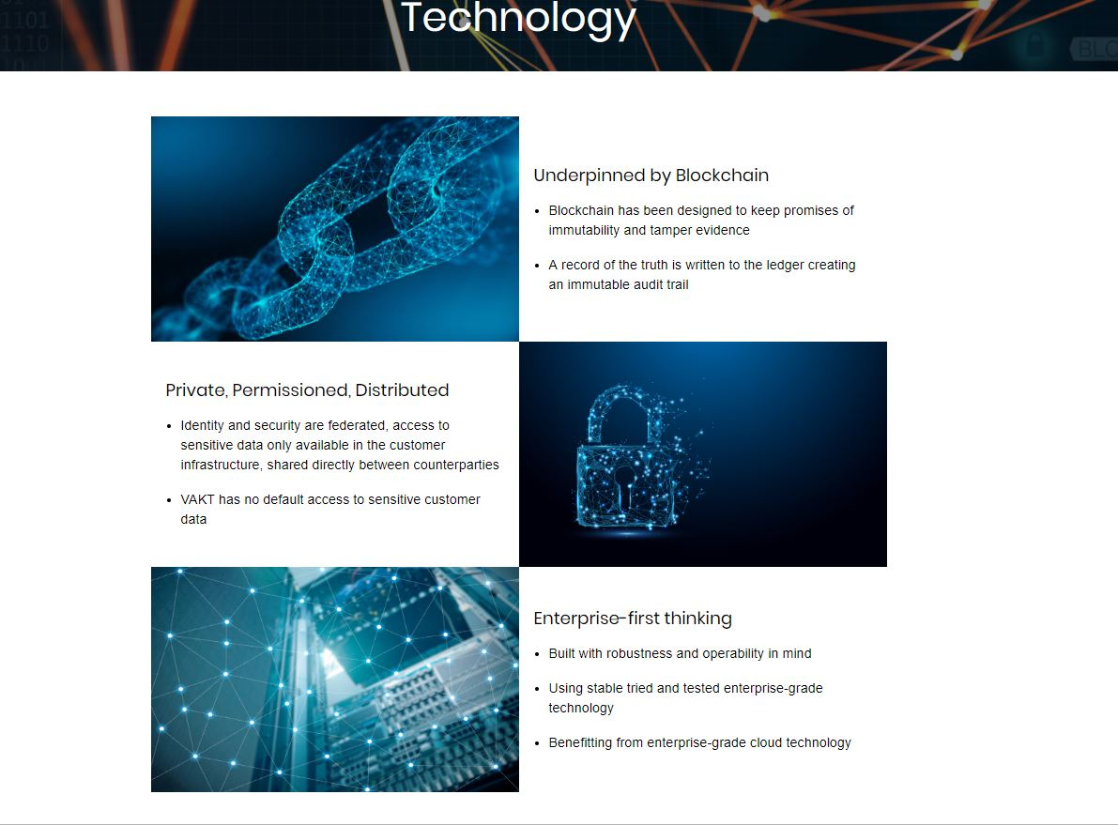

Slide 37
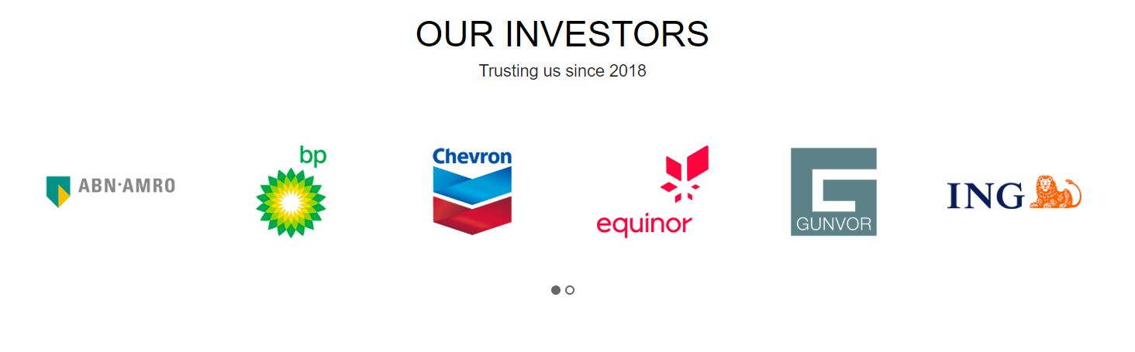

Slide 38


Slide 39
key takeaways
Blockchain is … [definition] → NOT AGAIN !
Bitcoin is a blockchain (the 1st ever created) - but not every blockchain is Bitcoin
What the internet was to information, blockchain is to transactions
which means that …
it may have many business applications in general
and in the energy sector in particular

Slide 40
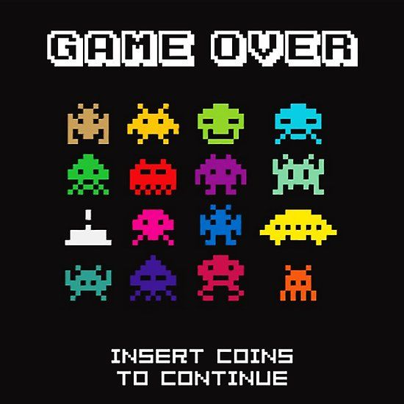
thank you!

